Slide 1
Automatic test suite generation
Sireesh

Slide 2
Introduction
What is software testing?
Unit testing
Testing smallest module in the system.
Isolated from rest of the code.
Proven to detect large percentage of defects.
Notes:
What is software testing? – Process of measuring correctness of a software program. Usually, a lot of time is devoted to testing phase of software development, atg seems to be a very useful approach.

Slide 3
What is ATG?
Generate unit test cases automatically.
Saves huge time and effort when writing tests for already existing code.
Several tools available:
Commercial: AgitarOne, Jtest, SilverMark Test Mentor etc.
Free: CodePlex, Evosuite, Randoop, Palus etc.
Performance metrics (optimization criteria):
Code coverage
Mutation scores : Measure of test suite detecting and killing mutants.
Size of test suite

Slide 4
Evosuite
Generate random test suites as an initial population.
Test suite evolved using genetic algorithm to satisfy given coverage criterion.
Default : Branch coverage
Branch coverage performed on byte code (which has only ‘if’ clauses)
Minimize best resulting test suite.
Apply post-processing steps to increase readability.
Add assertions.

Slide 5
Genetic algorithm
Method for solving optimization problems using natural selection.
Uses bio-inspired operators
Crossover – Interchange the test methods among test suites
Mutation – Insert, delete, modify
Selection – Best test suite

Slide 6
Evosuite algorithm (overview)
Current population <= Generate random population
Repeat
Z <= Elite of current population
While |Z| not equals |current population|
do
P1,P2 <= select two parents with rank selection
if crossover probability then
O1, O2 <= Crossover P1,P2
else
O1, O2 <= P1, P2

Slide 7
Evosuite algorithm (overview)
Mutate O1, O2
fp = min(fitness(P1), fitness(P2))
fo = min(fitness(O1), fitness(O2))
lp = length(P1) + length(P2)
lo = length(O1) + length(O2)
Tb = best individual of current population
if(fo<fp or fo=fp lo<=lp) then
for O in {O1, O2} do
if length(O) <= 2*length(Tb) then
Z <= Z {O}

Slide 8
Evosuite algorithm (overview)
else
Z <= Z {P1 or P2}
else
Z <= Z {P1, P2}
until solution found or maximum resources spent

Slide 9
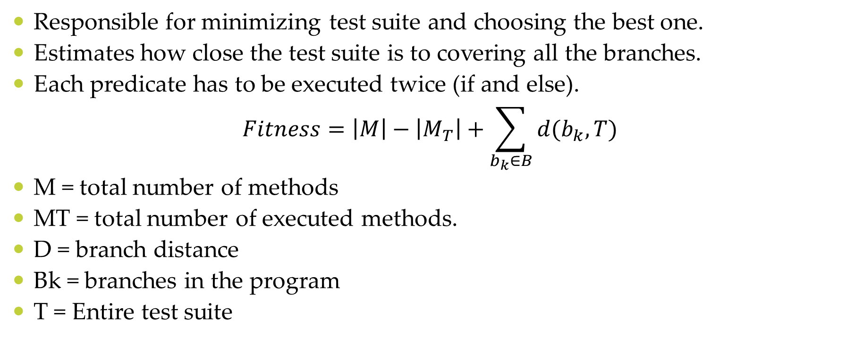
Fitness function
Responsible for minimizing test suite and choosing the best one.
Estimates how close the test suite is to covering all the branches.
Each predicate has to be executed twice (if and else).
$$Fitness=\left|M\right|−\left|M_{T}\right|+\sum_{b_{k}∈B}{d(b_{k},T)}$$
M = total number of methods
MT = total number of executed methods.
D = branch distance
Bk = branches in the program
T = Entire test suite
Notes:
The branch distance is a common heuristic to guide the search for input data to solve the constraints in the logical predicates of the branches.

Slide 10
Producing assertions
Uses mutation analysis.
Runs tests on
Original class.
Mutated versions of the class.
Record necessary information.
Generates assertions to kill mutants.
Types:
Primitive
Object comparison
String
Null
Exception

Slide 11
Using Evosuite
Commandline
“C:\Program Files\Java\jdk1.8.0_65\bin\java.exe" -jar evosuite-1.0.3.jar -class tutorial.Stack -Djunit=tutorial.StackTest -projectCP Tutorial_Stack\bin
Eclipse plugin
Review tests and add/edit assertions in the end to capture intended behaviour.

Slide 12
Results (from SBST 2016)
Ran with benchmark classes that represent typical object oriented classes.
Around 100 classes used.
Line coverage average – 73.9%
Branch coverage average – 65.6%
Mutation score – 41%
Runtime – 480 seconds for each class.

Slide 13
Conclusion
Has seen only limited uptake in industry.
Positives –
Can achieve significant structural coverage.
Takes very less effort and time compared to manual testing.
Negatives –
Readability (improving)
Generates too many assertions
Does not seem to improve ability of testers to detect faults

Slide 14
References
A. Arcuri, J. Campos, and G. Fraser, “Unit Test Generation During Software Development: EvoSuite Plugins for Maven, IntelliJ and Jenkins,” in IEEE International Conference on Software Testing, Verification and Validation (ICST), 2016, pp. 401-408.
G. Fraser and A. Arcuri, “EvoSuite at the SBST 2016 Tool Competition,” in 9th International Workshop on Search-Based Software Testing (SBST’16) at ICSE’16, 2016
G. Fraser, M. Staats, P. McMinn, A. Arcuri, and F. Padberg, “Does Automated Unit Test Generation Really Help Software Testers? A Controlled Empirical Study,” ACM Transactions on Software Engineering and Methodology (TOSEM), vol. 24, iss. 4, p. 23, 2015.
G. Fraser and A. Arcuri, “Whole Test Suite Generation,” IEEE Transactions on Software Engineering, vol. 39, iss. 2, pp. 276-291, 2013.
G. Fraser and A. Zeller, “Mutation-Driven Generation of Unit Tests and Oracles,” IEEE Transactions on Software Engineering, vol. 38, iss. 2, pp. 278-292, 2012.
http://www.evosuite.org/study/
THANK YOU

